Slide 1

ECG Signal Processing for Arrhythmia Detection Team Members: 1) 21BLC1058 – V M Adhityaa 2) 21BLC1472 – S Vinodh 3) 21BLC1569 – A Navaneth
Project Guide – Dr. Ranjeet Kumar

Slide 2
Introduction
Cardiovascular Diseases and the Role of ECG
Cardiovascular diseases (CVDs) are the leading cause of death globally, accounting for nearly 20 million deaths annually.
Arrhythmia, caused by irregular heart rhythms, is a critical condition under CVDs that necessitates early detection for effective treatment and management.
ECG signals, which record the heart's electrical activity, serve as the benchmark for diagnosing arrhythmias and other heart conditions.
Challenges in Traditional Detection Methods
Manual interpretation of ECG signals:
Time-consuming and prone to human error.
Unsuitable for high-scale diagnosis.
Detecting conditions like arrhythmia requires distinguishing subtle variations in the ECG waveform, which can be challenging manually.
Need for automated and efficient systems for accurate detection.

Slide 3
Introduction
Advancements in Automated Detection
Machine learning and deep learning techniques have revolutionized arrhythmia detection by automating ECG signal analysis.
Deep learning architectures, especially hybrid models, have shown exceptional potential in extracting spatial and temporal features from ECG data.
Objective of This Study
Develop a hybrid deep learning model combining:
CNN (Convolutional Neural Networks) for spatial feature extraction.
BiLSTM (Bidirectional Long Short-Term Memory) for temporal feature learning.
Gated Convolutions to enhance feature representation.
Ensure high accuracy and efficiency in arrhythmia detection.

Slide 4
Problem Formulation
Problem Definition:
Cardiac arrhythmias are abnormal heart rhythms that can be life-threatening if not detected early.
Traditional ECG analysis methods often involve manual interpretation by experts, which can be time-consuming, subjective, and prone to human error.
Current automated ECG classification systems face challenges in accurately detecting arrhythmias, especially with large and diverse datasets that include noise, class imbalance, and temporal dependencies.
Key Challenges:
Noise in ECG signals: ECG data is often corrupted by power line interference, baseline drift, and muscle activity, which affects the accuracy of detection.
Class imbalance: Some arrhythmia types are underrepresented in datasets, leading to biased predictions and reduced performance in detecting less frequent arrhythmia types.
Temporal and spatial feature extraction: Accurately capturing both the spatial (waveform characteristics) and temporal (time-dependent patterns) dependencies in ECG signals is crucial for effective classification.
Objective:
Develop a robust deep learning-based model combining CNN and BiLSTM and Gated Convolution to automatically detect and classify cardiac arrhythmias from ECG signals.

Slide 5
Research Objective
Hybrid Deep Learning Model Development:
Develop a hybrid deep learning model by combining CNN for spatial feature extraction, BiLSTM for temporal learning, and Gated Convolution for enhanced feature representation to improve arrhythmia detection.
Improved Arrhythmia Detection:
Achieve high accuracy and reduce false positives/negatives to ensure reliable detection of heart conditions, especially rare arrhythmias.
Enhanced Efficiency and Generalization:
Ensure computational efficiency and generalization across diverse ECG datasets for broader applicability in real-time diagnostics.

Slide 6
Proposed System

Slide 7
Proposed System Introduction
The proposed system is designed for automated arrhythmia detection using the MIT-BIH Arrhythmia Database. It integrates signal processing techniques with a hybrid deep learning model to classify ECG signals into five categories: Normal (N), Supraventricular Ectopic (S), Ventricular Ectopic (V), Fusion (F), and Unknown (Q).
The system consists of the following key stages:
Signal Preprocessing: This stage includes denoising the raw ECG signals to remove noise and artifacts, detecting R-peaks using Pan-Tompkins algorithm, segmenting heartbeats, and addressing class imbalance to ensure robust training.
Data Splitting: Preprocessed data is split into 80% training and 20% testing sets to facilitate model training and evaluation.
Hybrid Model Architecture:
Feature Extraction: A combination of 1D Convolutional Neural Networks (CNNs) and Gated Convolutions is employed to extract spatial and temporal features from ECG signals.
Sequence Modeling: A Bi-directional Long Short-Term Memory (BiLSTM) network captures contextual dependencies in the extracted features.
Classification: The hybrid model outputs predictions for the five arrhythmia classes.
Performance Evaluation: The model's performance is validated using metrics such as accuracy, sensitivity, specificity, and F1 score.
This system leverages signal processing and deep learning to provide an efficient and reliable approach for arrhythmia detection, addressing the challenges of noise, data imbalance, and real-time classification.

Slide 8
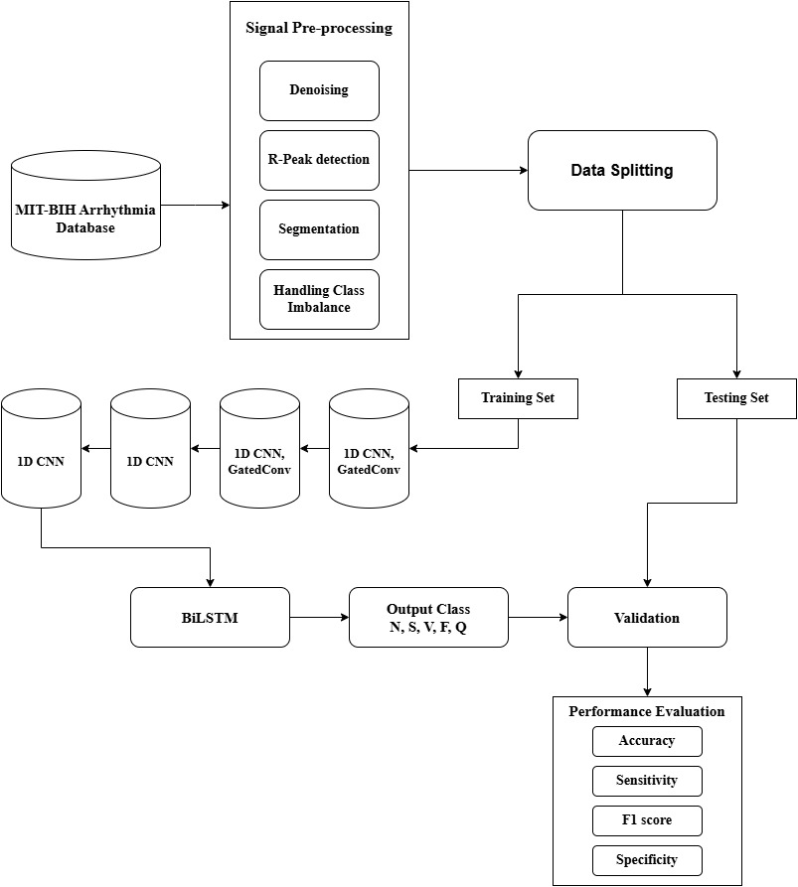
Proposed System Diagram

Slide 9
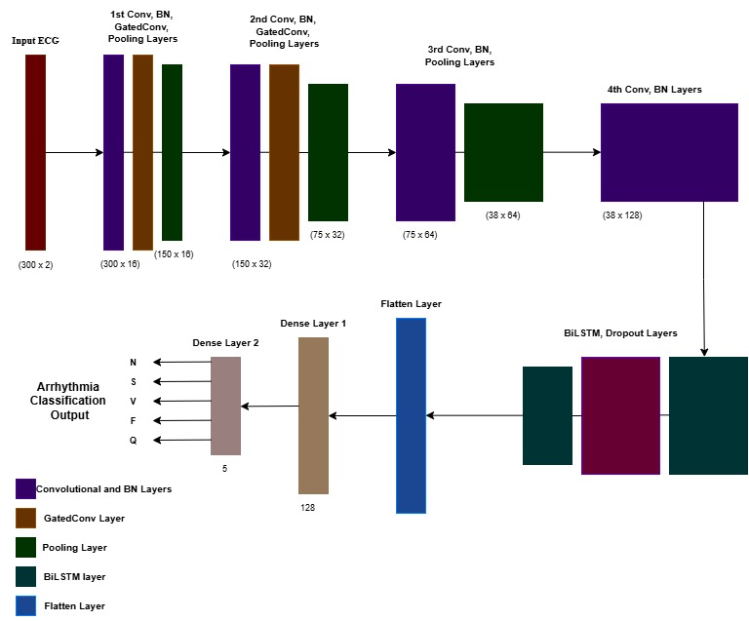
Architecture of proposed model

Slide 10
System Modules
Load MIT-BIH Dataset
The MIT-BIH Arrhythmia Database is loaded using the wfdb library.
ECG signals are retrieved from the database for each subject (e.g., 100, 101, etc.), using two channels of data.
The annotations for R-peaks and arrhythmia class labels are extracted using the rdann function.
The signals and their corresponding annotations are stored in arrays for further processing in the pipeline.
Denoising the ECG Signal
Use Discrete Wavelet Transform (DWT) to denoise the ECG signal.
Apply Daubechies wavelet (db5) for noise reduction.
Decompose the signal into wavelet coefficients.
Perform thresholding on detail coefficients to remove noise.
Reconstruct the signal using the filtered coefficients.
Resulting signal is cleaner, retaining key features like QRS complexes, P-waves, and T-waves.

Slide 11
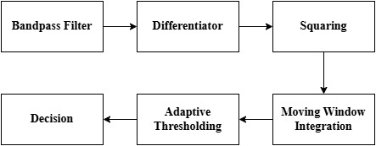
System Modules
R-Peak Detection using Pan-Tompkins Algorithm
Use the Pan-Tompkins algorithm for detecting R-peaks in the ECG signal.
Bandpass filter applied to remove noise.
Perform differentiation to highlight rapid changes in the ECG.
Apply squaring to emphasize significant features.
Moving window integration smooths the signal.
Use adaptive thresholding to detect R-peaks.
Heartbeat Segmentation
Segment ECG signal into individual heartbeats using detected R-peaks.
Each heartbeat is isolated into a fixed-length segment of 300 samples.
99 samples before the R-peak and 201 samples after the R-peak are used for segmentation.
Both channels of ECG data are used for segmentation.
Segmented heartbeats are prepared for further analysis and classification.
Data Balancing and Augmentation
Address class imbalance in the dataset.
Use SMOTE (Synthetic Minority Oversampling Technique) for data balancing.
SMOTE generates synthetic samples for underrepresented arrhythmia types.
Balancing the data ensures the model doesn’t favor majority classes.
Improved generalization and performance in detecting all arrhythmia types.

Slide 12
System Modules
Model Architecture and Training:
Define a custom Gated Convolution layer to enhance feature extraction.
Use Conv1D layers with varying filter sizes and kernel sizes for capturing ECG signal features.
Apply batch normalization to stabilize learning and speed up convergence.
Incorporate pooling layers (MaxPooling and AveragePooling) to reduce feature map dimensions.
Add Bidirectional LSTM layers to capture temporal dependencies in ECG signals.
Use dense layers after LSTMs to learn high-level features for classification.
Compile the model using the Adam optimizer and sparse categorical crossentropy loss.
Train the model with a 20% validation split .
Plot training and validation accuracy and loss curves to evaluate model performance over epochs.
Results and Analysis
Evaluate model performance using accuracy and loss metrics on both training and test sets.
Generate confusion matrix to assess per-class predictions.
Compute classification metrics: sensitivity, specificity, F1 score, and per-class accuracy.

Slide 13
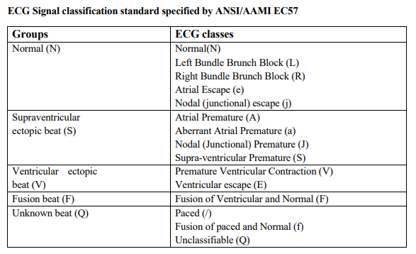
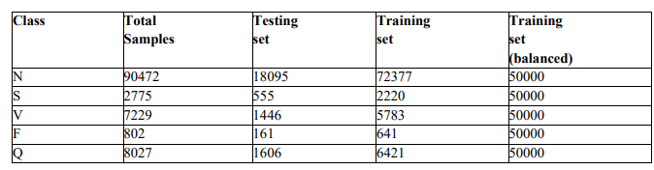
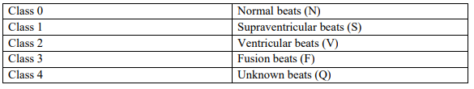
Table showing the mapping of class labels to numbers
Table displaying the number of samples in each class

Slide 14


Implementation Results
The model was trained using the CNN-BiLSTM with gated convolutions architecture for 30 epochs, with the training dataset consisting of 250000 samples. The goal was to evaluate the model’s performance in terms of its ability to learn from the data and generalize well to unseen data.
The proposed model’s performance was compared with another model with a standard CNN-LSTM architecture. Below are the results showing the training and test accuracy of the models:
CNN-BiLSTM with gated convolutions
CNN-LSTM

Slide 15
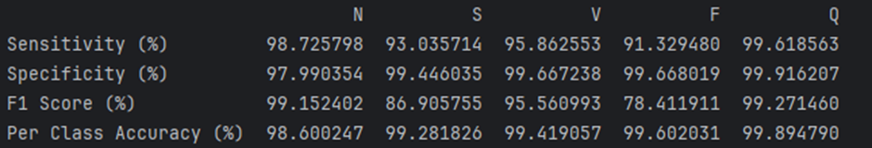
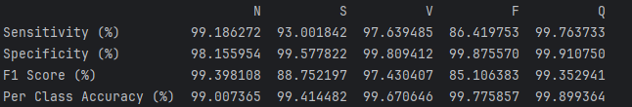
Implementation Results
Per-class performance metrics of the proposed model
Before class balancing:
After class balancing:

Slide 16
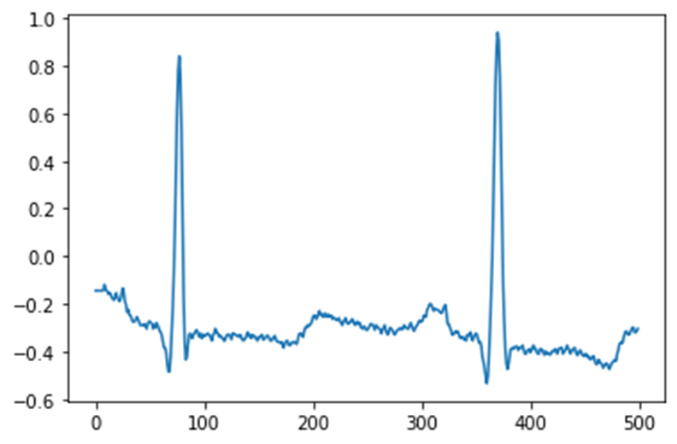
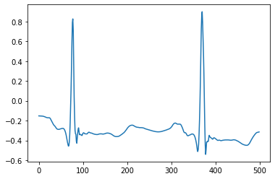
Plots
Discrete Wavelet Transform Denoising Output
Raw ECG Signal
Denoised Signal

Slide 17
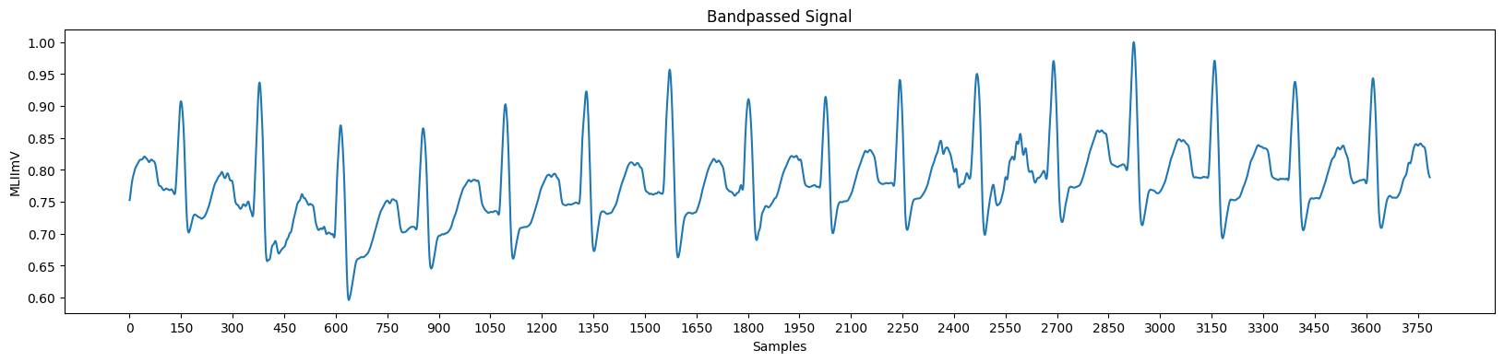
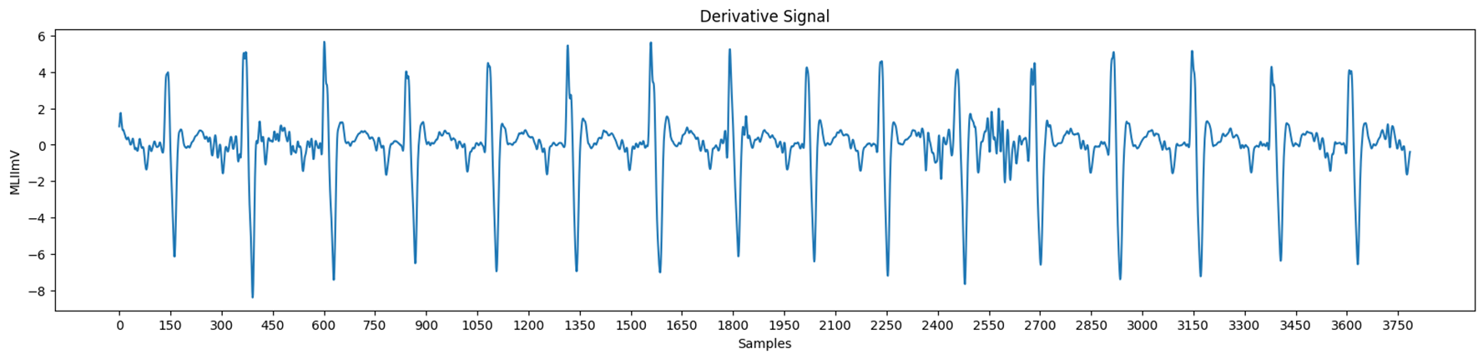
Plots
Bandpassed signal
Differentiated signal:

Slide 18
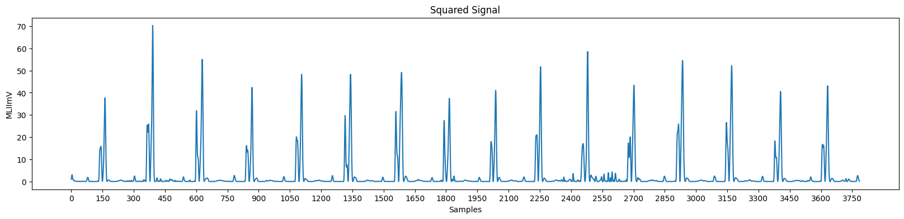
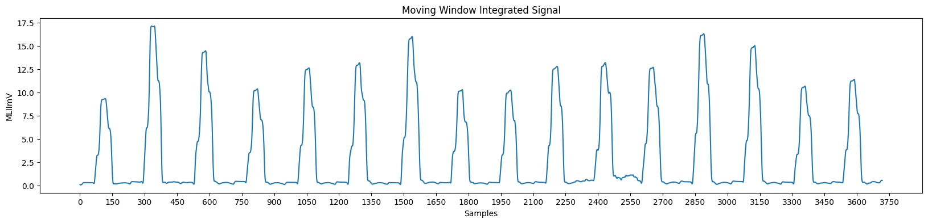
Plots
Squared Signal:
Moving Window Integrated Signal:

Slide 19
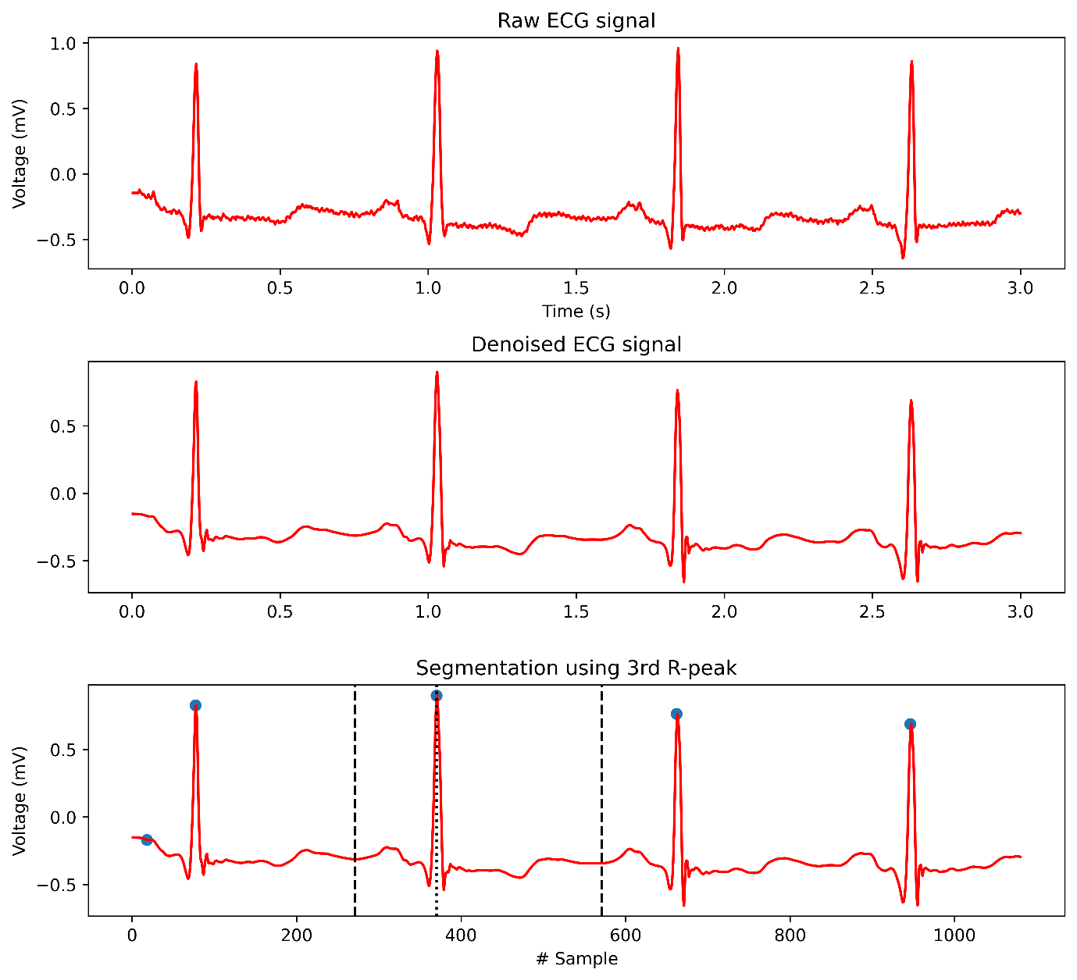
Plots

Slide 20
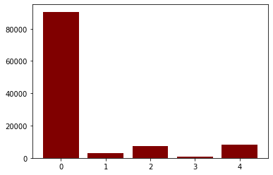
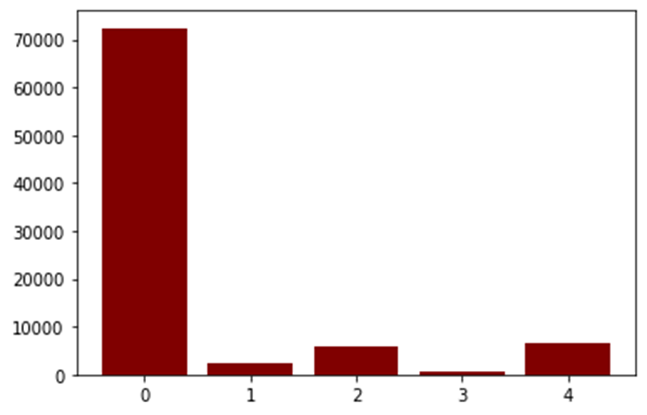
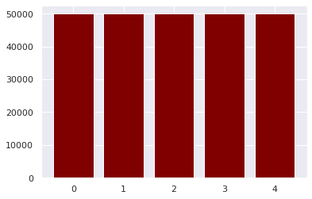
Plots
No. of samples per each class in dataset
No. of samples per each class in training set before class balancing
No. of samples per each class in training set after class balancing

Slide 21
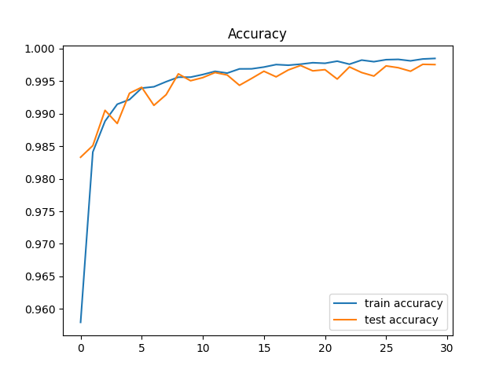
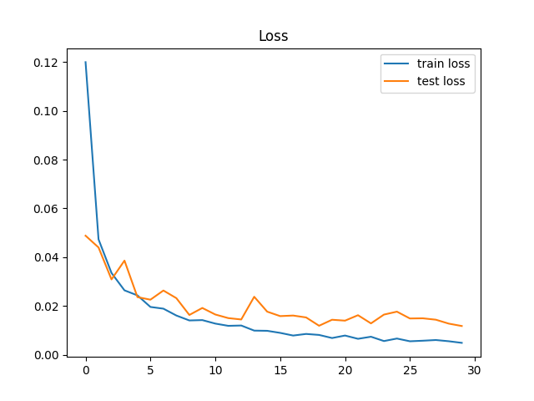
Plots
Accuracy and Loss curves of the model during training for 30 epochs

Slide 22
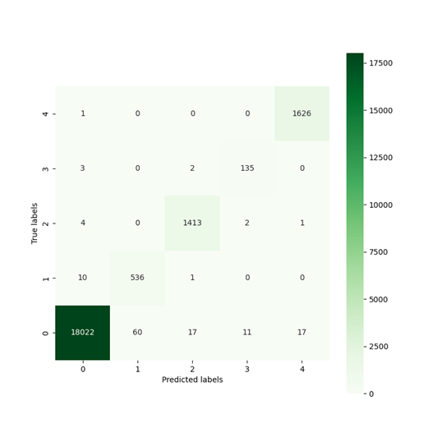
Confusion Matrix
Confusion matrix of the proposed model

Slide 23
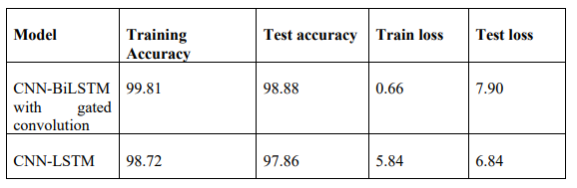
Interpretation and Findings
Performance Comparison
The performance of both models is compared based on their training accuracy, test accuracy, loss, and other evaluation metrics. The following results were obtained:
The addition of Gated convolutions and Bidirectional LSTM layers significantly improved the training accuracy and test accuracy, while the model performed slightly worse in terms of test loss compared to the simpler CNN-LSTM model.
The CNN-LSTM model achieved slightly lower training accuracy and test accuracy, but showed better test loss. This suggests that the simpler model might generalize better in certain cases, despite the proposed model being more accurate overall.

Slide 24
Per-Class Performance Analysis:
The per-class accuracy matrix provided insights into how well the model classified each ECG class. The model performed well with common classes like N (Normal) and V (Ventricular), achieving high accuracy and F1 scores. However, it struggled with minority classes such as S (Supraventricular) and F (Fusion), showing lower accuracy and F1 scores due to their limited sample sizes.
The model achieved the following per-class sensitivities and F1 scores:
Challenges with Minority Classes:
Despite implementing class balancing techniques such as SMOTE to generate synthetic samples for the underrepresented classes, the model struggled with accurately classifying the S and F classes. This resulted in reduced sensitivity and F1 scores for these classes: 93% for S and 86.49% for F in terms of sensitivity, and F1 scores of 88.75% and 85.10%, respectively.
Even after balancing the classes, the model's bias towards the majority classes was not fully mitigated. The synthetic data generated for the F class did not fully capture the complex characteristics of F class beats, leading to poor generalization and reduced accuracy. This highlights the difficulty of dealing with imbalanced datasets, particularly when synthetic data fails to represent the complexity of rare instances.
Class | Sensitivity | F1 score
N | 99.186 | 99.39
S | 93.001 | 88.75
V | 97.639 | 97.43
F | 86.49 | 85.10
Q | 99.76 | 99.35

Slide 25
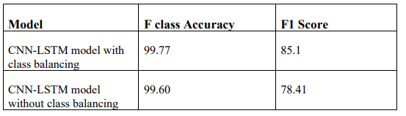
Impact of SMOTE on Model Performance:
To address the class imbalance in the MIT-BIH dataset, the SMOTE technique was applied to generate synthetic samples for the minority F class. This class balancing technique significantly improved the model’s performance, especially in classifying the minority class F.
The performance comparison between the model trained with and without class balancing is as follows:
Performance Before Class Balancing: The model showed reduced accuracy and F1 score in classifying the F class without handling the class imbalance. This reflected the model’s bias toward the majority classes and the challenge of predicting rare F class beats effectively.
Performance After Class Balancing: The application of SMOTE resulted in a significant improvement in both accuracy (99.77%) and F1 score (85.10%) for the F class. The balancing technique helped reduce the performance gap, highlighting the effectiveness of SMOTE in dealing with class imbalance.

Slide 26
Conclusion
This project focused on developing a deep learning model for ECG arrhythmia detection using the MIT-BIH dataset.
The model leveraged SMOTE for handling class imbalance and advanced CNN-LSTM architectures with gated convolutions to improve classification performance.
The model achieved an overall high accuracy of 98.88% with CNN-BiLSTM with gated convolution, demonstrating its robustness in classifying common arrhythmia classes such as N and V.
The minority class F showed lower performance due to the inherent challenges of class imbalance, despite the application of SMOTE to balance the dataset.
The comparative performance of a CNN-LSTM model further validated the benefits of the gated convolution approach, where the CNN-BiLSTM with gated convolution outperformed the standard CNN-LSTM model.

Slide 27
Future Scope
Future work could explore more advanced architectures like Transformers, Attention Mechanisms, or Graph Neural Networks to handle long-range dependencies and improve classification, especially for challenging arrhythmias. While more computationally complex, these models could enhance performance and generalization, particularly with multi-lead ECG data.
Exploring multimodal learning approaches, where additional data sources are combined with ECG signals, can provide richer context for better classification performance, leading to more accurate and comprehensive cardiovascular disease detection.
The use of multi-lead ECG data instead of the 2-lead setup used in this study can capture more comprehensive cardiac information, which could help extract more crucial features and improve the accuracy of arrhythmia detection. Using multi-lead data can potentially detect subtle patterns that may be missed with a single-lead ECG.
Addressing Class Imbalance More Effectively: Further refinement of class balancing techniques, such as using Generative Adversarial Networks (GANs) for data augmentation, could improve classification performance especially for minority classes

Slide 28
Outcomes
Developed a deep learning-based ECG arrhythmia detection system using CNN-BiLSTM with gated convolutions.
Achieved high training accuracy (99.81%) and test accuracy (98.88%).
Utilized SMOTE to address class imbalance, improving the classification of minority classes like F.
Improved the F1 score of the F class from 78.41% to 85.10% with class balancing.
Compared performance with a CNN-LSTM model, demonstrating the superiority of the CNN-BiLSTM model.
The model shows potential for accurate and early detection of cardiovascular diseases.

Slide 29
References
Daydulo, Y.D., Thamineni, B.L. & Dawud, A.A. Cardiac arrhythmia detection using deep learning approach and time frequency representation of ECG signals. BMC Med Inform Decis Mak 23, 232 (2023). https://doi.org/10.1186/s12911-023-02326-w
Singh, A.K., Krishnan, S. ECG signal feature extraction trends in methods and applications. BioMed Eng OnLine 22, 22 (2023). https://doi.org/10.1186/s12938-023-01075-1
Sun, A.; Hong, W.; Li, J.; Mao, J. An Arrhythmia Classification Model Based on a CNN-LSTM-SE Algorithm. Sensors 2024, 24, 6306. https://doi.org/10.3390/s24196306
Bhatia, S.; Pandey, S.K.; Kumar, A.; Alshuhail, A. Classification of Electrocardiogram Signals Based on Hybrid Deep Learning Models. Sustainability 2022, 14, 16572. https://doi.org/10.3390/ su142416572
M. AlMahamdy and H. B. Riley, "Performance study of different denoising methods for ECG signals," in Proc. of the 4th International Conference on Current and Future Trends of Information and Communication Technologies in Healthcare (ICTH-2014), Athens, USA, 2014.
Din S, Qaraqe M, Mourad O, Qaraqe K, Serpedin E. ECG-based cardiac arrhythmias detection through ensemble learning and fusion of deep spatial-temporal and long-range dependency features. Artif Intell Med. 2024 Apr;150:102818. doi: 10.1016/j.artmed.2024.102818. Epub 2024 Feb 24. PMID: 38553158.
H. A. Shah, F. Saeed, M. Diyan, N. A. Almujally, and J.-M. Kang, "ECG‐TransCovNet: A hybrid transformer model for accurate arrhythmia detection using Electrocardiogram signals," CAAI Transactions on Intelligence Technology, 2023. DOI: 10.1049/cit2.12293
Automatic detection for cardiac arrhythmia based on ECG and deep learning approaches. Li, Z. (Author). 1 Aug 2024
Karoui, Hend & Hamza, Sihem & Benayed, Yassine. (2024). Deep Learning for Cardiac Diseases Classification. 10.1007/978-3-031-70816-9_14.
S. Chatterjee, R. S. Thakur, R. N. Yadav, L. Gupta, and D. K. Raghuvanshi, "Review of noise removal techniques in ECG signals," IET Signal Processing, E-first, Sept. 15, 2020. DOI: 10.1049/iet-spr.2020.0104.

Slide 30
Thank You

